Slide 1
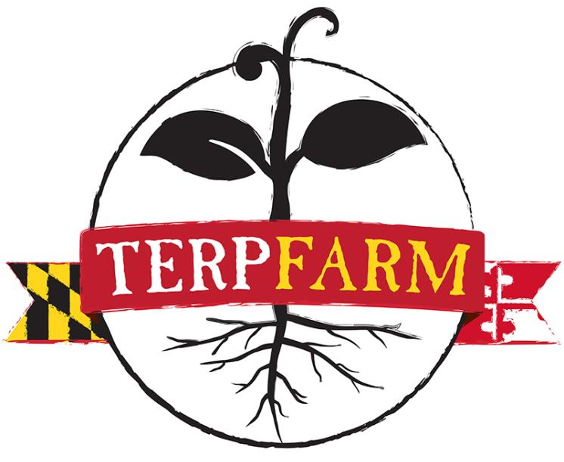

Slide 2
Presentation Outline
Background & Introduction
Green Dining
Terp Farm Pilot
Year One Outcomes
Next Steps
Terp Farm – Year One
Summer
Fall
Winter
Spring

Slide 3
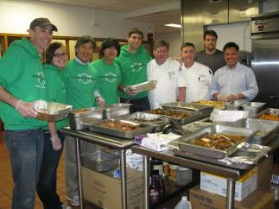
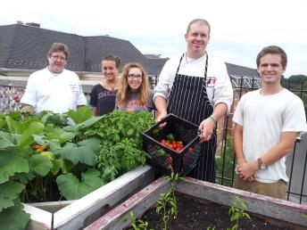
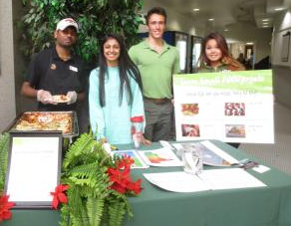
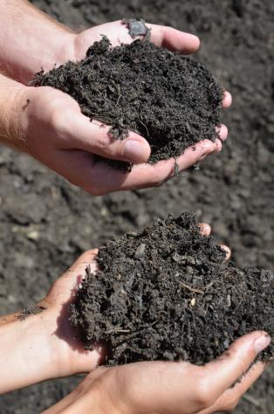
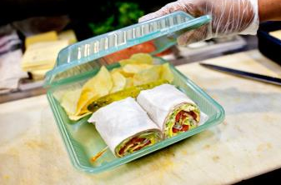
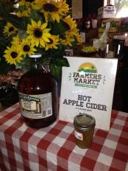
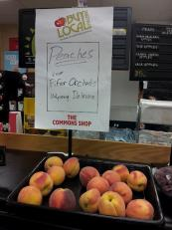
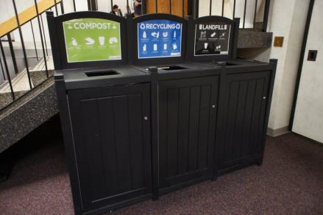
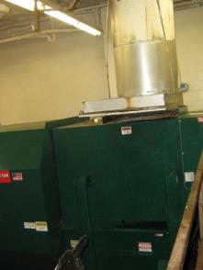

Slide 4
Background: Green Dining
2012 Sustainable Food Commitment:
1-4% annual increase in sustainable food purchases based on financial feasibility and product availability
Annual, incremental increases in sourcing from local growers, with special emphasis on Maryland growers and harvesters
Annual, incremental increases in sourcing of unprocessed, whole foods
20% sustainable food by 2020
Sustainable Food Committee

Slide 5
Background: Terp Farm Pilot
Collaboration
Department of Dining Services
College of Agriculture and Natural Resources
Maryland Agricultural Experiment Station
Plant Sciences and Landscape Architecture
Institute of Applied Agriculture
Office of Sustainability
Pilot Funding
University of Maryland’s Sustainability Fund: $124,400 for 3-year Pilot Program

Slide 6
Background: Terp Farm Pilot (cont.)
Mission:
Offer sustainable, four-season vegetable production for Dining Services
Donate fresh produce to those in need at UMD and in our community
Provide educational opportunities for the UMD students and the broader community
Staffing
Guy Kilpatric, Dining Services Lead Agricultural Technician
Green Dining Team
Summer student staff team
Location
2+ acres at Upper Marlboro Facility Central MD Research and Education Center, 15 miles from Campus

Slide 7
Sustainability at Terp Farm

Slide 8
Year One Outcomes: Crop Yield

Slide 9
Year One Outcomes: Produce Deliveries

Slide 10
Year One Outcomes: Student Engagement
2014 Student Engagement:

Slide 11
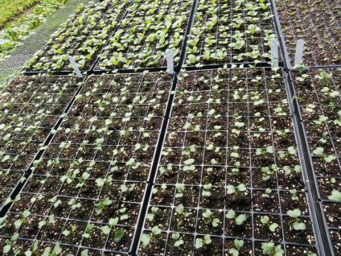
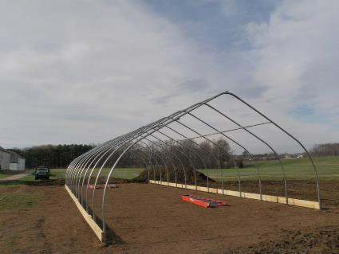
Next Steps
2015 – first full growing season
Enhance infrastructure
Greenhouse
Second high tunnel
GAP certification & washing stations
Ongoing collaboration with culinary team
Increase student and community engagement
Academic courses
Living Learning programs
Open volunteer days
Farm tours
Harvest festival
Student research
More!

Slide 12
Terp Farm – Year One
Summer - July 2014
Notes:
Good morning! Thank you so much for introduction Allison and inviting me to speak this morning. It’s hard to believe that my adventure with Terp Farm began just about a year ago now.
Introduction
I’ll first give you a brief introduction about myself. My name is Karyn Owens and I’m a Senior Plant Science student here at the university focusing on Horticulture and Crop Production as well as minoring in Sustainability. I was born and raised in Calvert County, just 30 minutes south of Annapolis, where I also received my Associate’s degree from the College of Southern Maryland. I grew up on family farmland, but didn’t realize I wanted to farm myself until I was almost 20. I’ve spent the last two summers working on organic vegetables farm and I’m so excited to share that passion with you today.
From the moment I discovered that the Department of Dining Services was looking for full-time Terp Farm Student Staff members for the summer of 2014, I knew it was an experience that I wanted to be apart of. I first heard about the project through a TA for Professor Walsh’s introduction class last spring and rushed home to send the application in as soon as I could. And I’m fortunate that that dream became a reality this past summer, which inspired me to apply for this position again for the summer of 2015. But so much has happened in a year and I’ll paint a picture for you of seasons on the farm.

Slide 13
Terp Farm –Summer
Summer 2014: Student Staff Team Member
Typical Day at the Farm
7am – 3:30pm
7am : Arrive + Harvest in HT and Lower Field
8am – 12pm : Cultivation, Irrigation, Fertilization, or Planting
12pm – 12:45 pm : Lunch Break
12:45pm – 2pm : Individual Projects + Office Work
2pm – 3:30pm : Tool Maintenance, Weeding Gardens, Clean-Up
Notes:
1 of 3 students full-time.
For 3 college students, it took a little negotiation to decide when we’d start. Trying to beat the heat!

Slide 14
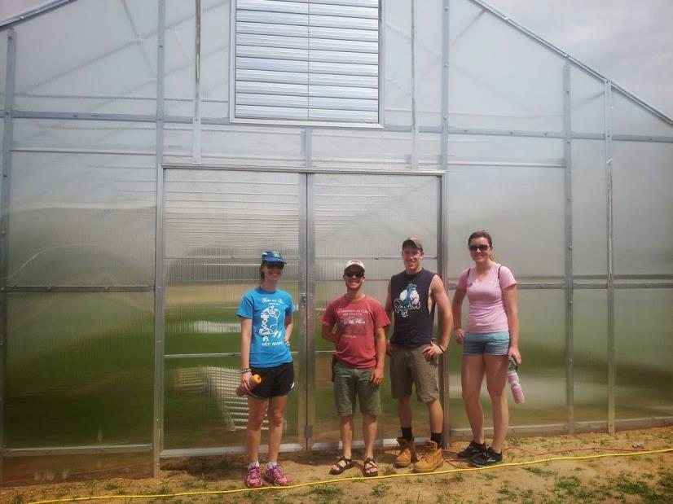
Summer – Day One
Notes:
Couldn’t believe this was Day 1. We toured the farm and got to know each other a little better!

Slide 15
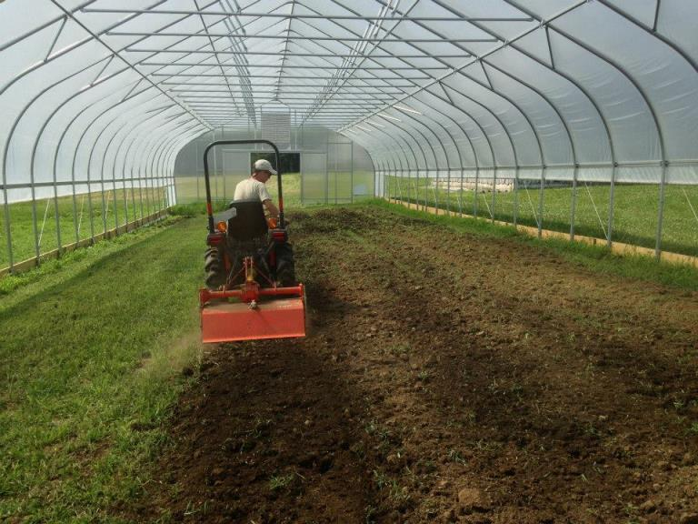
Summer - June 2014
Notes:
A group had constructed most of the high tunnel before we started and we finished up the rolling sides so that we could get started!
It was the first time it was cool enough to work in the high tunnel.

Slide 16
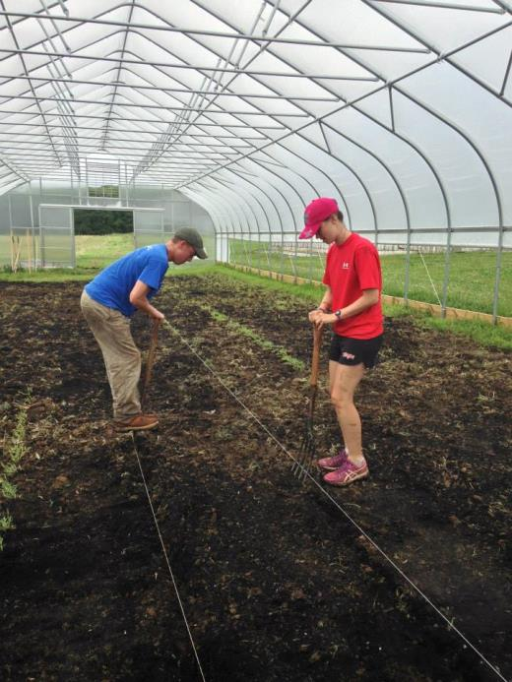
Summer - June 2014
Notes:
We completed all the work BY HAND. It’s amazing that you can go into the high tunnel now and the soil is incredibly soft.

Slide 17
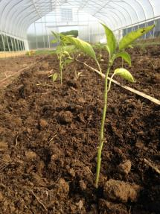
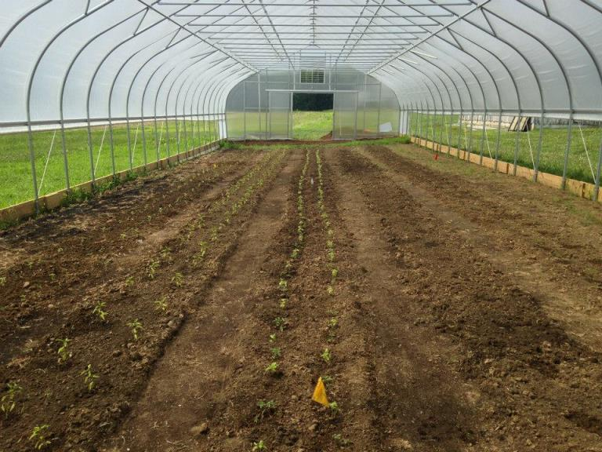
Summer - June 2014
Notes:
Here’s our first planting of tomatoes and peppers.
We received these transplants from elsewhere, so we had to give them a little hope and prayers.

Slide 18
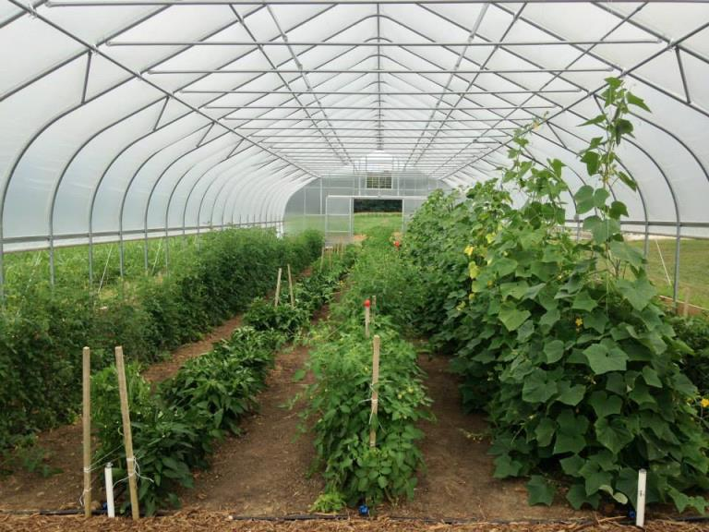
Summer - July 2014
Notes:
But I guess we didn’t need it after all because the high tunnel exploded in just a matter of weeks. Those cucumbers were to the ceiling!

Slide 19
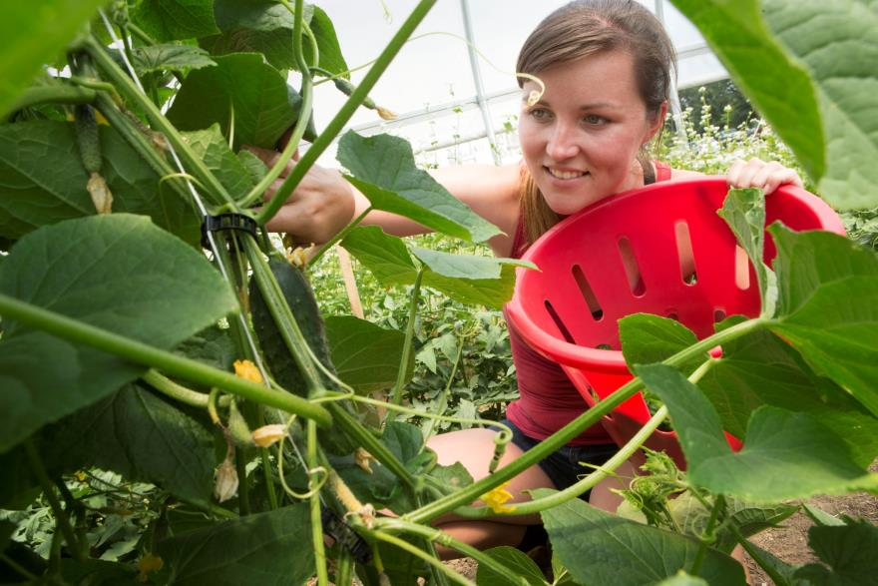
Summer - August 2014
Notes:
One of my favorite things in the morning was picking cucumbers with all of the bees buzzing around.

Slide 20
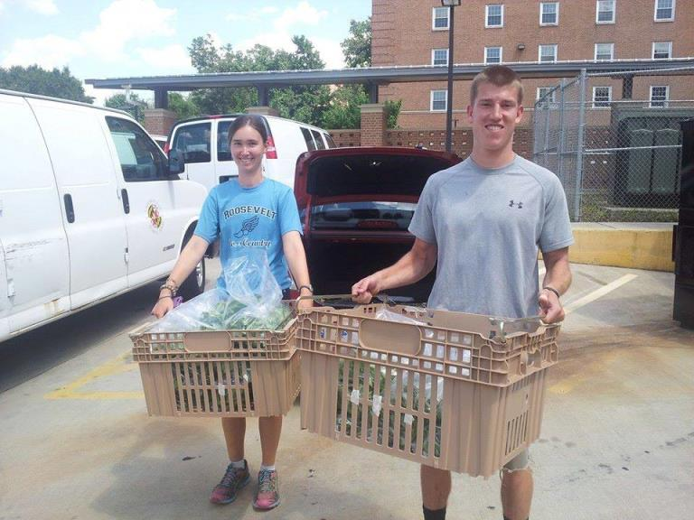
Summer - August 2014
Notes:
Wasn’t there, but this was our first harvest delivery to campus.

Slide 21
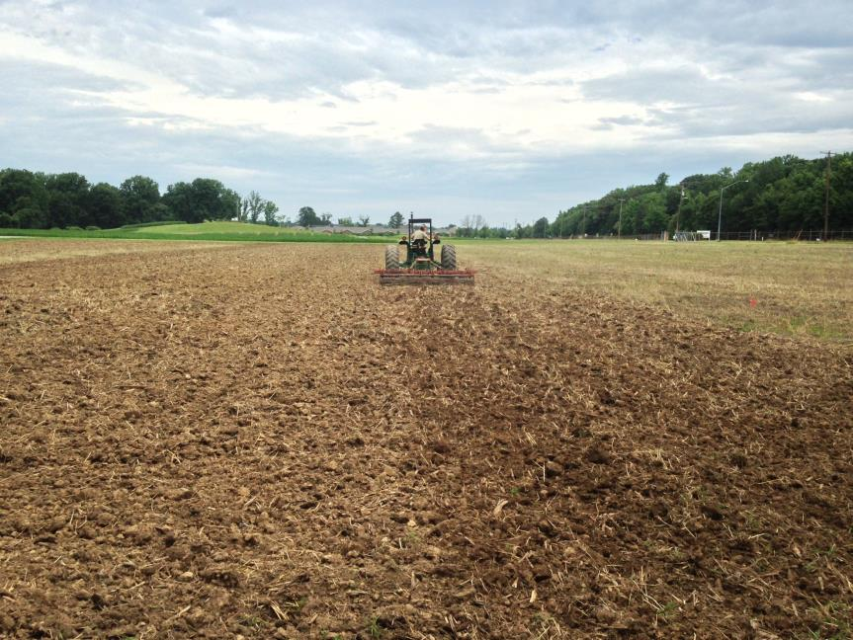
Summer - June 2014
Notes:
The field had previously been used for corn and soybean production.
We started from scratch essentially out in the field for our intensive vegetable production.

Slide 22
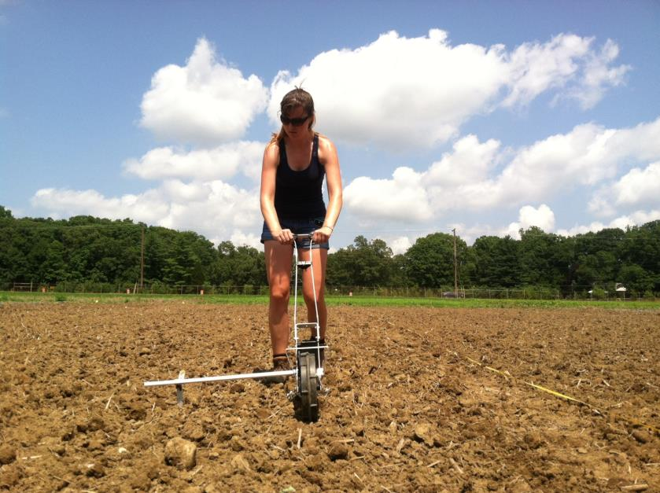
Summer - June 2014
Notes:
Most of our seeding was done by hand or broadcast, but here I got to use the seeder to plant sweet corn.

Slide 23
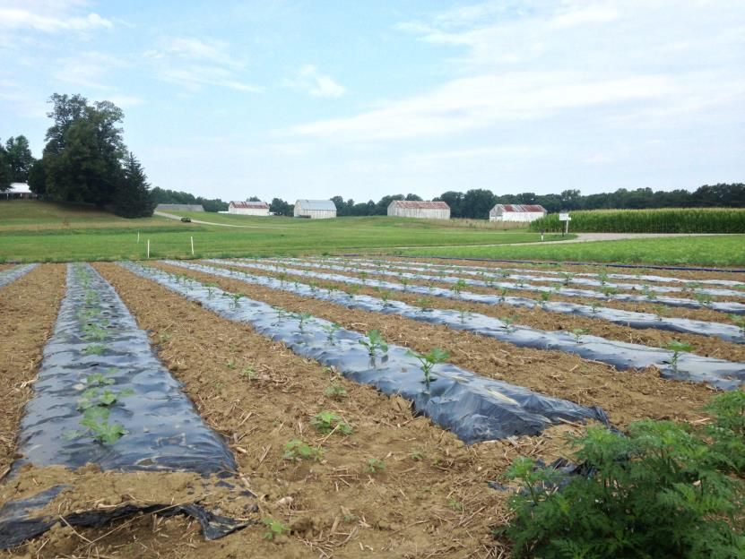
Summer – July 2014
Notes:
And here’s our squash in the field.

Slide 24
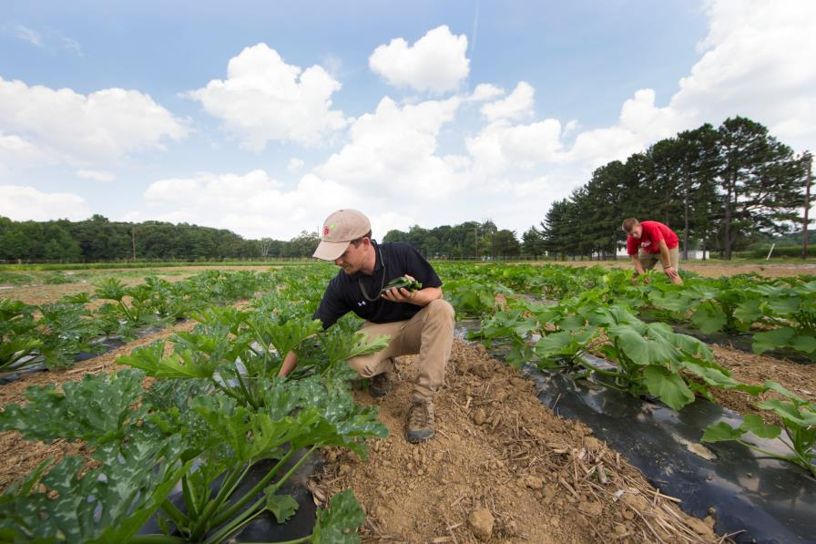
Summer - August 2014
Notes:
Guy harvesting zucchini!

Slide 25
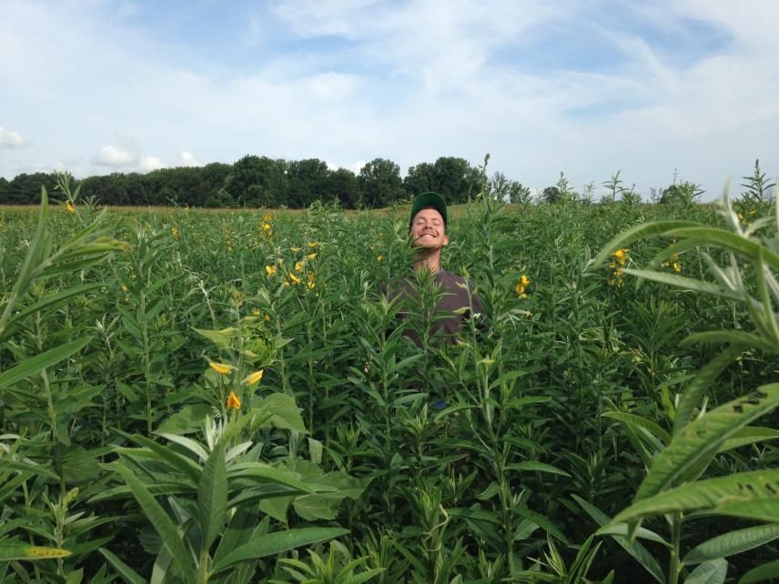
Summer - August 2014
Notes:
Here’s Guy hanging out in our cover crop planting with soon-to-be sunflowers.
Cover crop rotation is a very important part of our sustainability at Terp Farm.

Slide 26
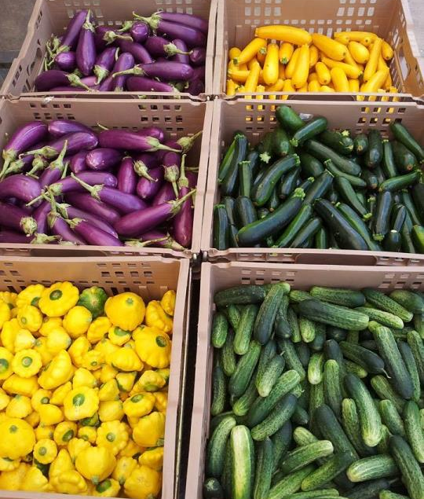
Summer - August 2014
Notes:
A quick look at one of our first harvests. Squash, cucumbers, and zucchini. Our baby patty pans!

Slide 27
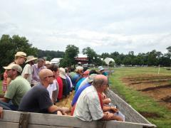
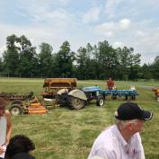
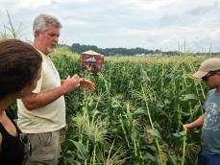
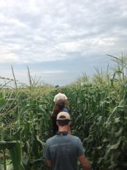
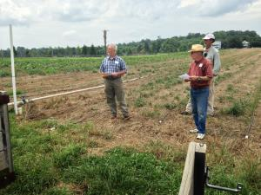
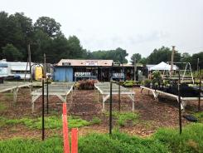
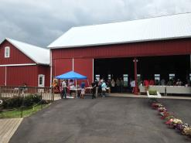
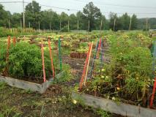
Field Trips
Larriland No-Till Seminar
Southern Maryland Field Day
Notes:
We went on field trips throughout the summer including a No-Till Seminar and visits to other MD farms

Slide 28
Terp Farm – Fall
Plant Sciences Fruit and Vegetable Technology Lab
Weekly visits to Terp Farm
Outreach & Promotion
Notes:
I was so happy that my experience didn’t have to end and I was still able to be at the farm in the fall once a week for Professor Walsh’s Fruit and Vegetable Technology Class.
I also worked with Allison and Guy to do some outreach and promotion for the farm as well.

Slide 29
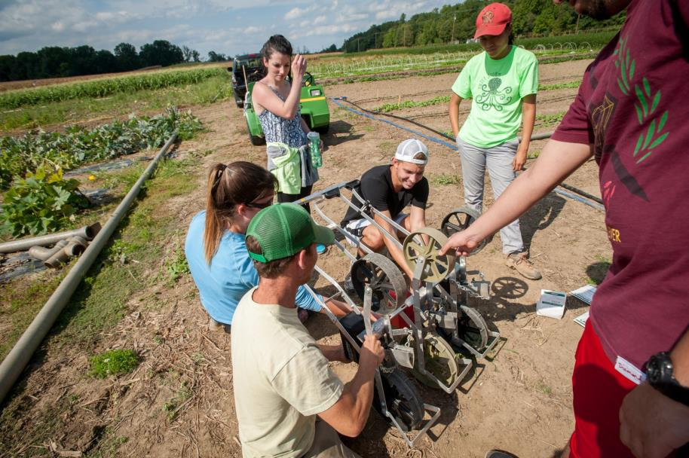
Fall - September 2014
Notes:
Here’s our class learning how to use the seeder.

Slide 30
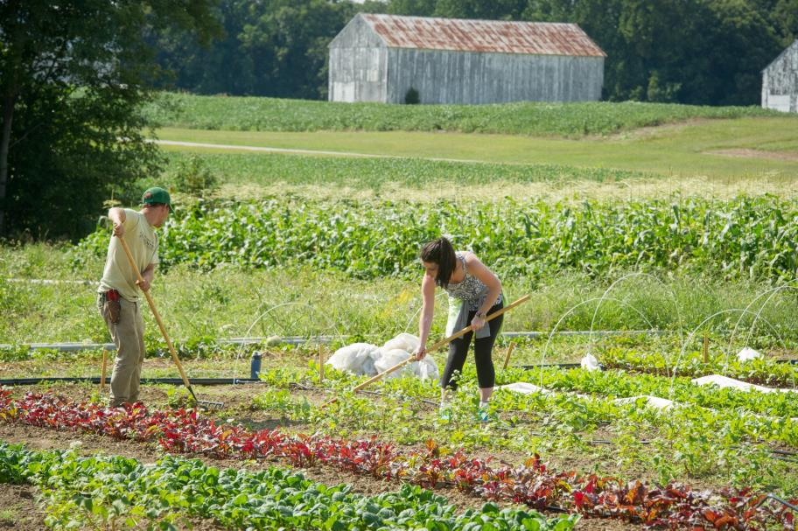
Fall - September 2014
Notes:
We were in the classroom once a week and out on the farm once a week.
We helped out with all aspects of farm production.

Slide 31
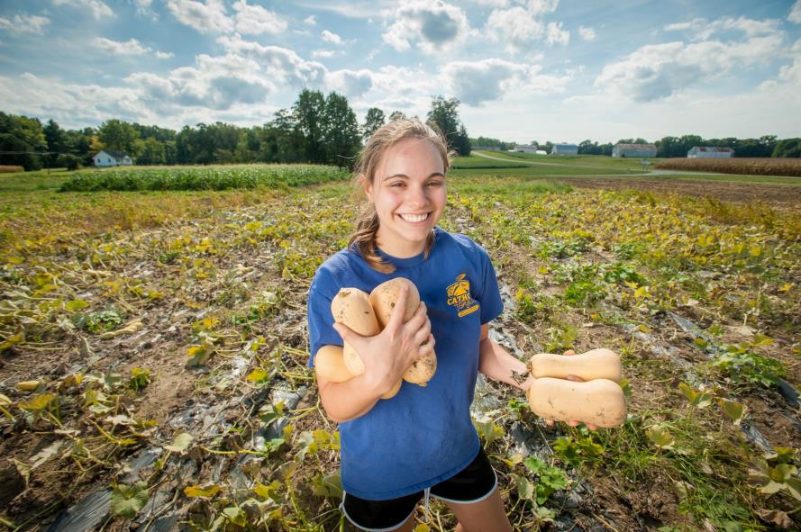
Fall - September 2014
Notes:
Including harvesting all of the vegetables we had planted over the summer.

Slide 32
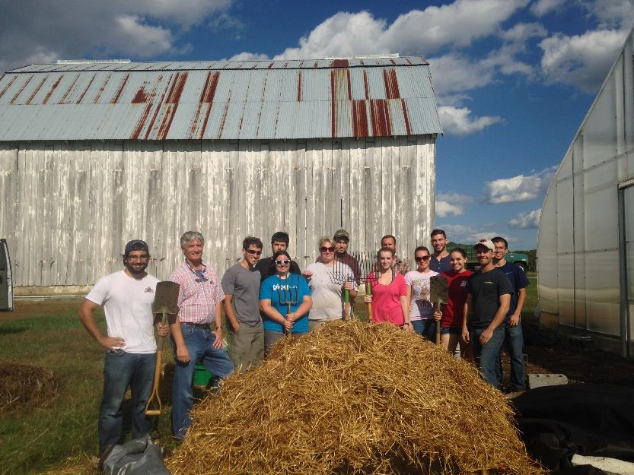
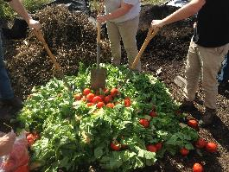
Fall - September 2014
Notes:
Here’s our class with our compost pile we made.
You can see how it all started from the picture from above!

Slide 33
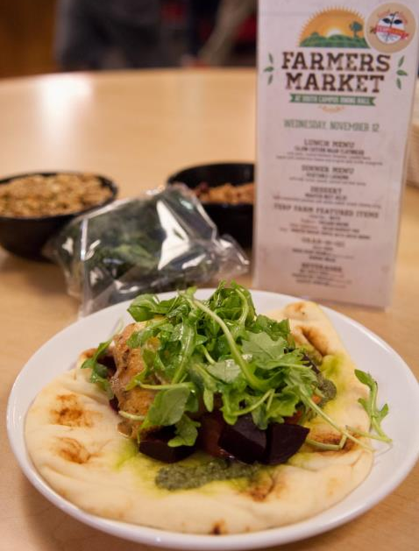
Fall - September 2014
Notes:
It’s so exciting to be working on a farm that grows food specifically for the dining halls and feed fellow Terps.

Slide 34
Terp Farm – Winter & Spring
Plant Science Capstone Project
Terp Farm Food Safety Plan
Future Harvest – Terp Farm High Tunnel Workshop
Notes:
I thought things would slow down a little bit, but that definitely didn’t happen.
In winter, we continued to grow in the high tunnel on the farm.
I also geared up for my Senior Capstone project to develop a food safety plan for the farm.

Slide 35
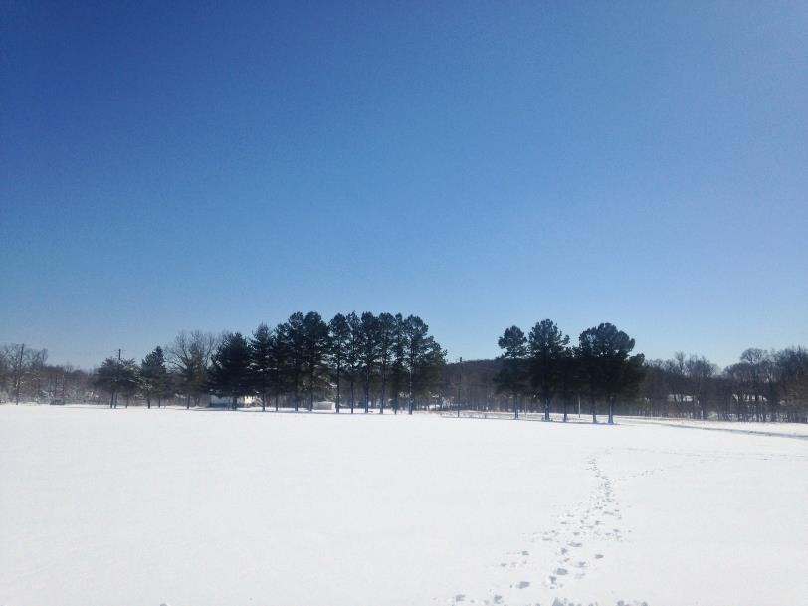
Winter – January 2014
Notes:
So you got a glimpse of what it looked like out in the field in the summer, here’s what it looks like in the winter. So beautiful!

Slide 36
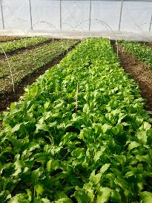
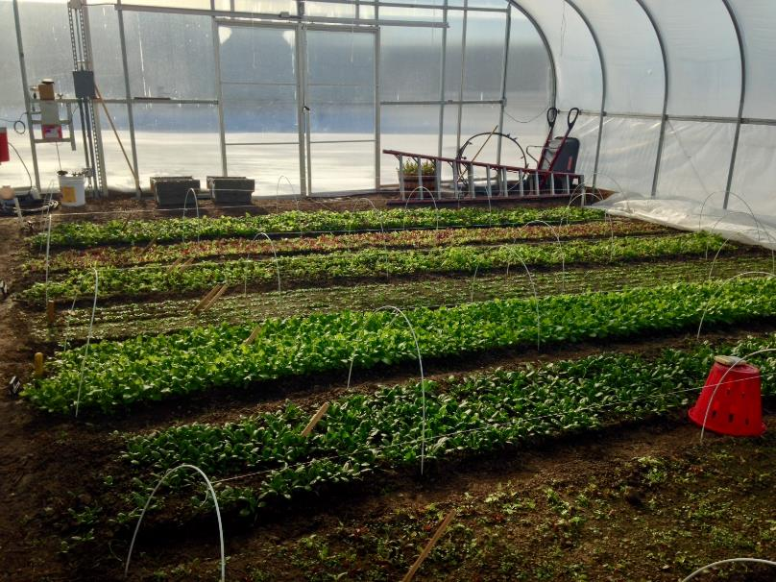
Winter – January 2014
Notes:
It was quiet out in the field during the winter
But in the high tunnel, we were growing a number of cold-hardy crops all winter long.

Slide 37
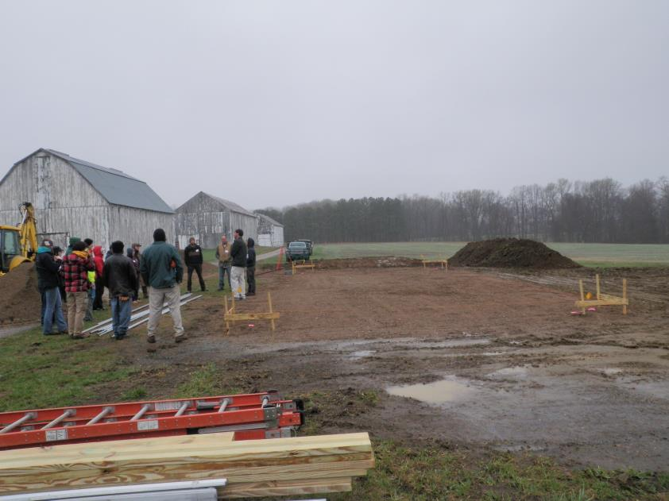
Spring – April 2014
Notes:
Just a few weeks ago, I attended a high tunnel workshop out on the farm. Here’s the site before.

Slide 38
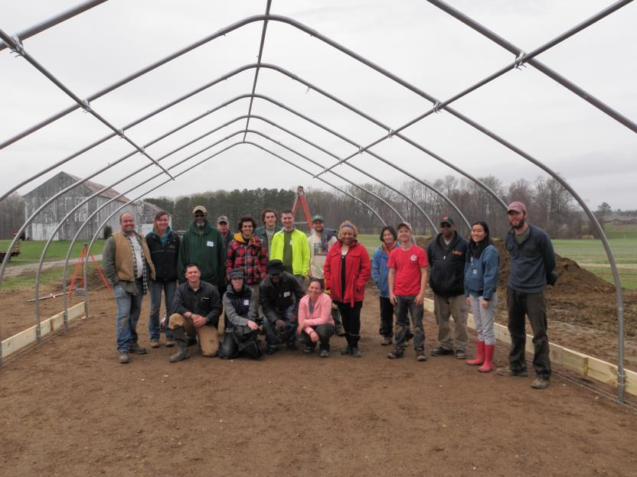
Spring – April 2014
Notes:
And after Day 1. I was 1 of 5 students along with 10 other farmers to attend this workshop.

Slide 39
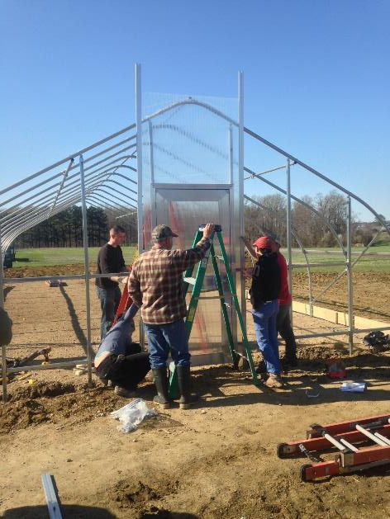
Spring – April 2014
Notes:
So here’s closer to the end of Day 2 finishing up the end wall of the new structure.

Slide 40
Terp Farm Food Safety Plan
Spring 2014
Notes:
Each PLSC student has to finish a capstone project and I knew I wanted to keep working on Terp Farm.
An important aspect of food safety is developing a plan, which I thought would be a great contribution I could make to the project.
I attended a food safety training through MDA, worked with food safety experts, and drafted the Food Safety Plan
I am looking forward to our audit in June.
It’s incredible that I will be able to see my project implemented!

Slide 41
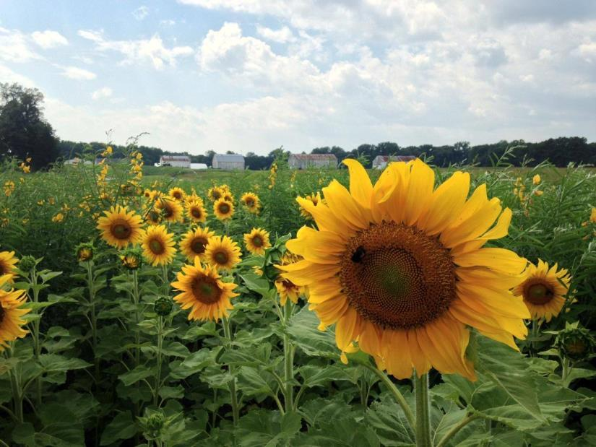
Notes:
Look at our beautiful sunflowers!
Final Notes
I’ve discovered how much I truly enjoy growing vegetables and being in the field. I have experienced all of the ups and down of starting a new farm, crop challenges, and finding out what it takes to be a farmer. Driving up to the farm each morning began to feel like home, someplace where I could relax my mind and do something I love. It was looking back at the pictures and watching our land transform from bare ground to vibrant soil that helped me understand the kind of impact Terp Farm has on the community at the University of Maryland. We’re not just Terps feeding Terps, but actually sowing the seeds for this farm to evolve as a model for sustainability and generation of future farmers.
Farming is in my blood and has been in my family for over a hundred years in Maryland. I hope to carry on their legacy and be an example for future generations. I plan to continue towards my dream of starting an organic vegetable farm after I finish my degree here at the University of Maryland, incorporating every bit of what I’ve learned through my education and experiences.

